Slide 1
Inheritance vs composition

Slide 2
Agenda
Inheritance vs composition in react.
With an example.

Slide 3
Inheritance
Object-Oriented Programming are well aware of Inheritance.
When a child class derives properties from its parent class,
Inheritance.

Slide 4
Composition
Object-Oriented Programming.
Inheriting properties from a base class,
Describes a class,
Reference one or more objects.
React prefers Composition over Inheritance.

Slide 5
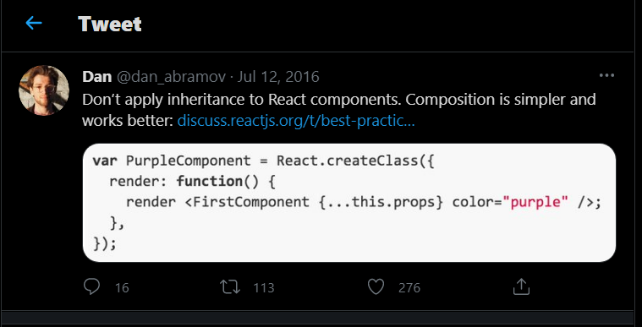
Composition

Slide 6
Composition
Code reuse and cleaner code structure.
Everything in React is a component.
Composition is a better approach than inheritance for code reuse.

